Slide 1
NAS FOR TRANSFORMERS
Seminar in Automated Machine Learning(in the Age of Large(Pre-Trained) Models)
MSc in Statistics and Data Science, Summer Semester 2024
Ludwig-Maximilians-Universität München
Iris Dania Jimenez
Prof. Dr. Matthias Feurer

Slide 2
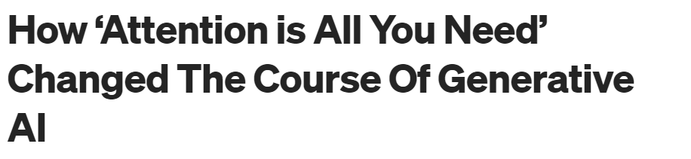
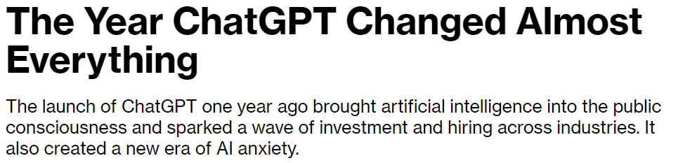
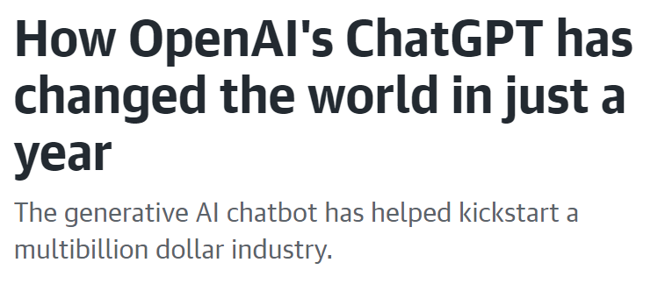
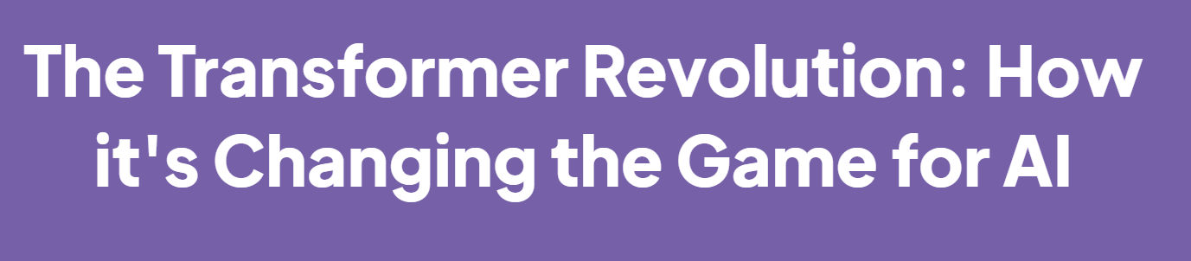
Top Left: https://medium.com/@pasha.khoshkeba/how-attention-is-all-you-need-changed-the-course-of-generative-ai-25b8c24ca430
Top Right: https://www.bloomberg.com/news/articles/2023-11-30/the-year-chatgpt-changed-almost-everything
Middle Left: https://www.engadget.com/how-openais-chatgpt-has-changed-the-world-in-just-a-year-140050053.html?
Bottom Right: https://www.dkube.io/post/the-transformer-revolution-how-its-changing-the-game-for-ai
Notes:
Transformers have revolutionazed the AI field and have become the de facto architecture in deep learning for a variety of tasks mainly in NLP and CV(Chitty-Venkata et al 2022) domains , with more than n papers( et al) since focused on them. Transformers have also capture the public and media's attention since the release of transformer based architecture like the GPT family.

Slide 3
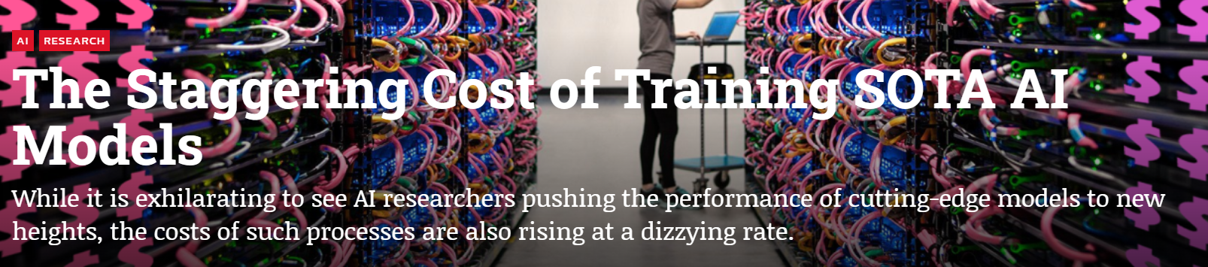

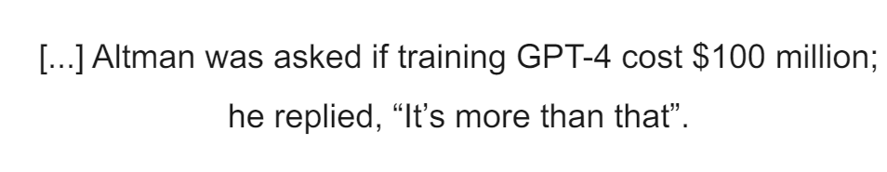
Top Left: https://syncedreview.com/2019/06/27/the-staggering-cost-of-training-sota-ai-models/
Bottom Left: https://www.wired.com/story/openai-ceo-sam-altman-the-age-of-giant-ai-models-is-already-over/
Right: (Vaswani et al., 2017)
Notes:
why should you cre pt 2
However, designing Transformer models is complex and labor-intensive due to their intricate architecture and the extensive computational resources required for training and optimization them.

Slide 4
Neural Architecture Search(NAS)
Automated search for optimal Transformer architectures
Enhanced model’s performance
Optimize Resource Utilization
Notes:
We can use NAS to help mitigate these problems. NAS can automate the search for the optimal Transformer architecture, enabling the development of high-performing models without excessive manual effort. As I will show you in this presentation, it has been shown that NAS can enhance the model's performance. Moreover, as we have seen, computational resources are a significant challenge for the development of new architectures. NAS can also help with this by optimizing for different hardware constraints, allowing experts to fully exploit the available computational power and resources efficiently.

Slide 5
AGENDA
Transformers
NAS
NAS for Transformers
Limitations & Future Directions
Notes:
In this presentation I will briefly go over the most important aspects of NAS and Transformers. Then I will focus on the most prominent NAS for transformers methods, than I will adress Future directions and limitations in this field.

Slide 6
Transformers
Transformers have obtained state-of-the-art(SOTA) performance on several NLP and CV tasks
Transformers-based architectures rely on the attention mechanism
High scalability and data parallel processing abilities
Image: (Vaswani et al., 2017)
Notes:
Transformer networks [4] have attracted significant interest over the last few years due to its effectiveness in handling long-range dependencies in data, and attained state-of-the-art (SOTA) performance on several Natural Language Process ing (NLP) tasks . The architecture and its family of networks rely on the Self-attention mechanism to model the global dependency in the input sequence data and exhibit high scalability, model capacity and data parallel processing as opposed to its predecessor, Long short-term memory (LSTM) [3].
And attention as presented in the 2017 paper by Vaswani et al 2017 also allow to parallelize the training of this architectures because basically the attention mechanism depends on different matrix andmultiplication and GPUs can handle matrix multiplication very well

Slide 7
Transformers: Training
Pre-training
Fine-tuning
Image: (Vaswani et al., 2017)
Notes:
Models are pre-trained on large corpora to learn general language representations.
Common tasks include language modeling, where the model predicts masked words or the next word in a sequence.
Fine-tuning
Pre-trained models are fine-tuned on specific downstream tasks (e.g., sentiment analysis, translation).
Fine-tuning involves adjusting the model weights with task-specific data to improve performance.

Slide 8
AGENDA
Transformers
NAS
NAS for Transformers
Limitations & Future Directions
Notes:
now that the foundamentals concepts of the Transformer architcture have been introduced we will explore further the field of NAS

Slide 9
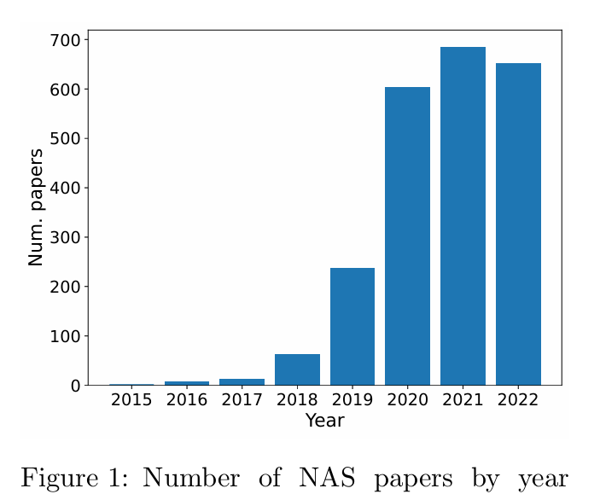
NAS: Overview
Graph: Deng and Lindauer, 2021
Notes:
1: (Chen et al., 2018; Du et al., 2020; Ghiasi et al., 2019; So et al., 2019; Zoph et al., 2018)
NAS found architectures
have outperformed or compete with human-designed ones in a variety of tasks¹
The number of paper published in NAS field has expectionally grown in the past few years(insert image from Deng and Lindauer, 2021) , highlighting the growing research and interest in this field. An intrest also due to the fact that NAS found architecture have outperformed or compete with human-desing ones in a variety of tasks. s (Chen et al., 2018; Du et al., 2020; Ghiasi et al., 2019; So et al., 2019; Zoph et al., 2018),[VITAS(ViT) by Su et al 2021 outperforms in terms of accurancy the human design ViT Swin(Liu et al 2021), Twins( Chu et al 2021), DeiT (Touvron et al 2021) on Imagenet ]

Slide 10
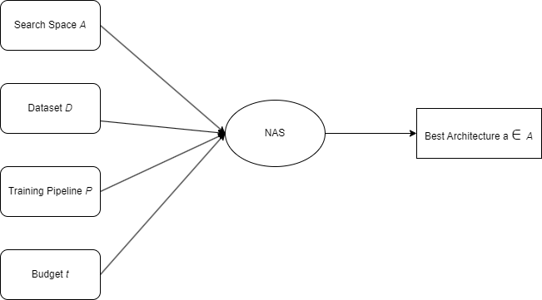
NAS: Definition
Notes:
: (Hutter et al., 2019)
The accepted and widely held definition of NAS is the following:
Given a search space A , a dataset D, a training pipeline P, and a time or computation budget t, the goal is to find an architecture a A within budget t which has the highest possible validation accuracy when trained sing dataset D and training pipeline P. (Hutter et al. 2019). so basically, we try to automatically find the best architecture for our task.

Slide 11
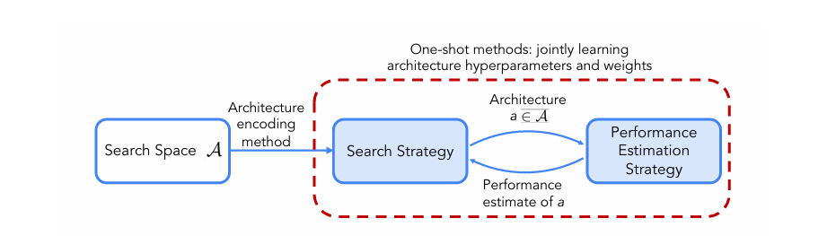
NAS: Components
Image: (Elsken et al., 2019; Weng, 2020)
Notes:
search space: the set of architectures that we can use
search strategy: method that we use to search for the optimal architecture
performance estimation strategy: how we evaluate the found architecture
and then we have a loop between the search strategy where we keep looking and evaluating different archtiectures until we found the best one according to our choosen metrics
a big subfield of NAS to which this categorization doesnt really apply is one shot model(where the search strategy is inherenlty link with also a performance startegy) (Xie et al., 2021)

Slide 12
NAS: Search Space
Definition:
It is the set of all architectures that the NAS algorithm is allowed to select
Transformers:
Chain structured
Cell based
Notes:
3:(White et al., 2023)
is the set of all architectures that the NAS algorithm is allowed to select(White et al., 2022), and it is very first step in setting un NAS method and very crucial because ir defines the foundation of the NAS procedure

Slide 13
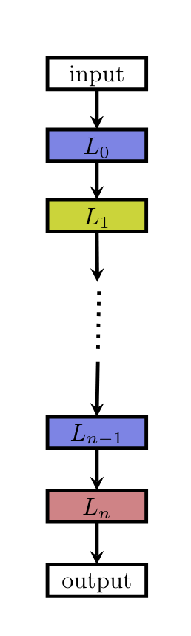
NAS: Search Space - Chain structured
Sequential chain of operation layers
Conceptually simple
Rarely leads to novel discoveries
Image: (Elsken et al., 2019)
Notes:
Chain-structured search spaces have a simple architecture topology: a sequential chain of operation layers are used to represent the architecture. the layers represent different operations like attention or linear transformation. since the operation are sequential this type of architectures are mostly used for encoder only architecture like BERT where we dont need to attend to the decoder
While these search spaces are easy to design and implement, their simplicity means there is a lower chance of discovering truly novel architectures.

Slide 14
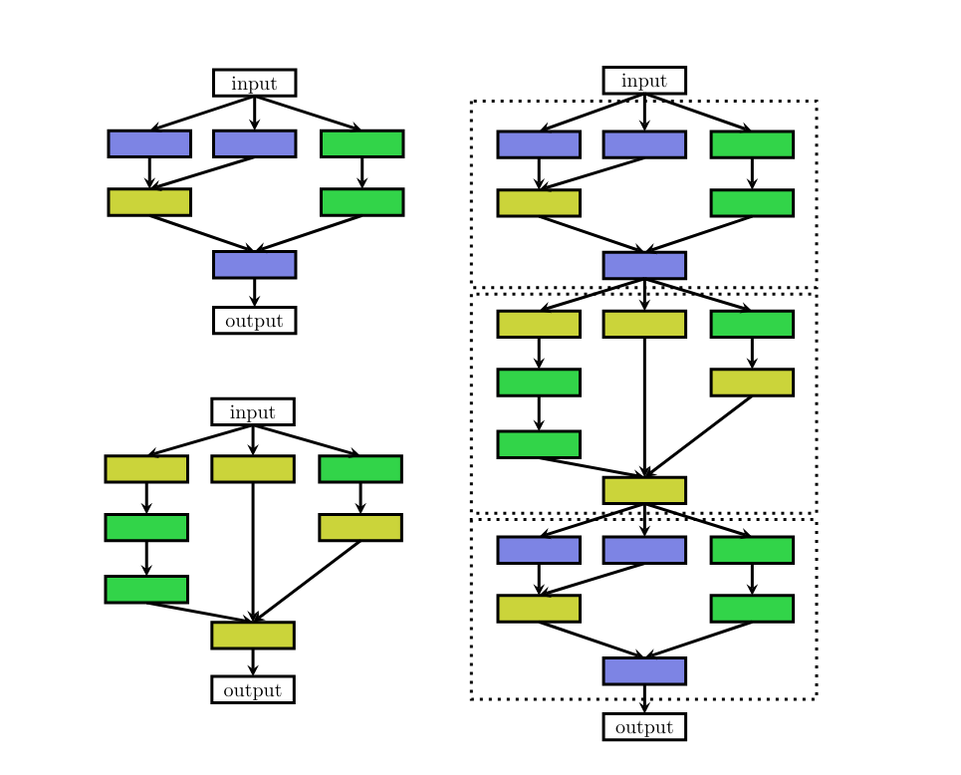
NAS: Search Space - Cell based
Create cells and reuse them
Operations and connections
Conceptually simple
Allow for complex representations
Image: (Elsken et al., 2019)
Notes:
probably the most popular search space in NAS((Chitty-Venkata et al 2022)). The main idea is to create cells and then reuse them multiple times to create the final architecture.
[mention who made it populer Zoph et al., 2018 NASNet normal and reduction cells]. What makes them so advantageous is that once you have found the internal structure of one cell you can stuck them multiple times(but you first need to decide a priori how meny times to stuck them aka macro structure has to be fixed a priori). In a cell search space what you are looking for are operations and connections. In transformers an example of operations can be how many head in MHSD and connetions how and when to apply skipped connections
maybe make an example of this is a cell, and this is another cell and how they connect together

Slide 15
NAS: Search strategy
Definition:
The optimization techniques used to find a high performance architecture in the search space
Transformers:
Evolutionary Algorithms
Notes:
the optimization techniques used to find a high performing architecture in the search space, basically the way we "query" the search space. There are different search strategies but in the Transformer field one of the most used search strategy is EA.

Slide 16
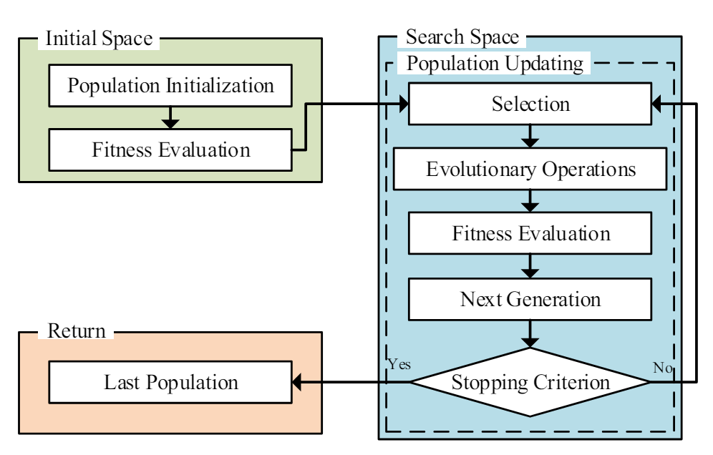
NAS: Search Strategy - Evolutionary Algorithms(EA)
Population of architectures
Flexible
Competitive results
Very susceptible to their own hyperparameters
Image: (Liu et al., 2021)
Notes:
Evolutionary NAS algorithms work by iteratively updating a population of architectures. In each step, one or more parent architectures in the population are sampled (typically based on the validation accuracy of the architectures), combined and mutated to create new children architectures. These architectures are then trained(SGD) and added to the population, replacing individuals in the population with worse performance. ((Chitty-Venkata et al 2022)).

Slide 17
NAS: Performance Estimation Strategy
Definition:
Any method used to predict the performance of an architecture
Performance estimation strategies for transformer architectures vary widely, with no universally adopted method.
Notes:
A performance estimation strategy can be defined as any method used to quickly predict the performance of an architecture. Once the architecture has been trained, its accuracy is utilized by the search strategy to select a superior architecture.
ere is not really a most used performance estimation strategy used with trasformers architecture so I will introduce for every specific case
kay so, so far we have review the three main components of NAS but there is also a large subfield of NAS which is extensevly used, especially for Transformers: One-shot Models.

Slide 18
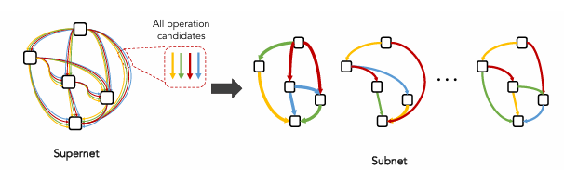
NAS: One-Shot Models
Bottom: (White et al., 2023)
Notes:
the idea is to train all architectures in the search space via a single("one shot") training of a supernetwork.(White et al., 2022). The supernetwork is a big network that encode all the possible architectures as sub-networks. the big advantage is that we can train an exponential number of architectures for a linar compute cost(White et al., 2022).
Edges are operation like convolution, attention and skipped connections. nodes are tensor(high dimensional matrices)
how to train a supernet: randomly sample one architecture, train for a few epochs and then updated the weights of all other architectures

Slide 19
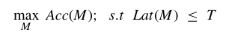
Hardware Aware NAS(HW-NAS)
Optimize for the best architecture and hardware performance metrics
Latency
Floating Point Operations Per Second(FLOPs)
Approached as a multi-objective optimization problem
arg
Formula: (Chitty-Venkata et al., 2022)
Notes:
there is a growing interest, primarily driven by financial incentives, in hardware considerations. Therefore, it is crucial to highlight hardware-aware NAS. This approach not only optimizes for the best architecture but also tailors it to the hardware platform by considering metrics such as latency[105], [106] FLOPS[70], energu ysage[107] and memory usage[108]. Typically, this problem is approached as a multi-objective optimization challenge.
latency: the time it takes for a neural network model to process an input and produce an output on a specific hardware platform. run inference(?)
FLOPS: FLOPS stands for Floating Point Operations Per Second. It is a measure of the computational performance of a neural network, indicating the number of floating-point calculations the network can perform in one second.

Slide 20
AGENDA
Transformers
NAS
NAS for Transformers
Limitations & Future Directions
Notes:
now that the foundamentals concepts have been introduced we will explore further the field of NAS applied to Transformers.

Slide 21
The Evolved Transformer
Advanced version of the Transformer
Developed using NAS
Enhanced performance in NLP tasks
Notes:
**Evolved Transformer** represents a significant evolution from the original Transformer architecture introduced by Vaswani et al. in 2017. It incorporates novel enhancements and optimizations aimed at addressing key limitations of the original model.

Slide 22
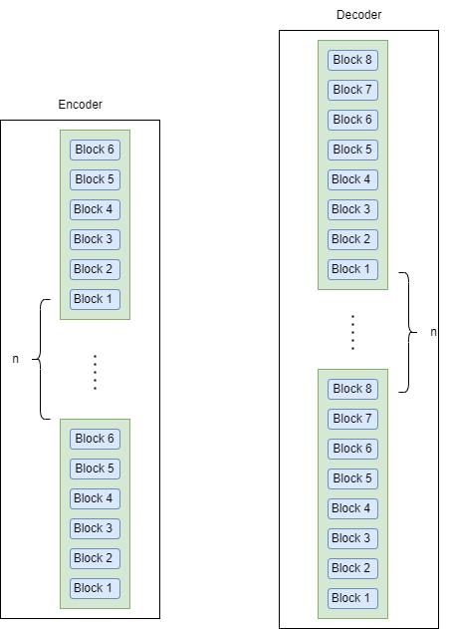
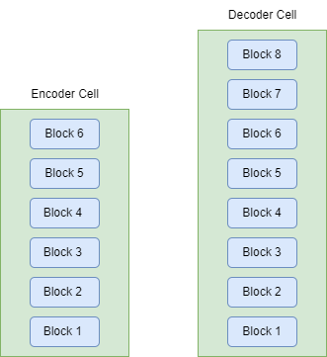
The Evolved Transformer: Search Space
Cell based
Notes:
It adopts a cell-based search space. the idea is two create two cells: one for the encoder and one for the decoder. these cells are composed od blocks: 6 for the encoder and 8 for the decoder. the final transformer archtiecture will be achieved by stakcing multiples time the cells.

Slide 23
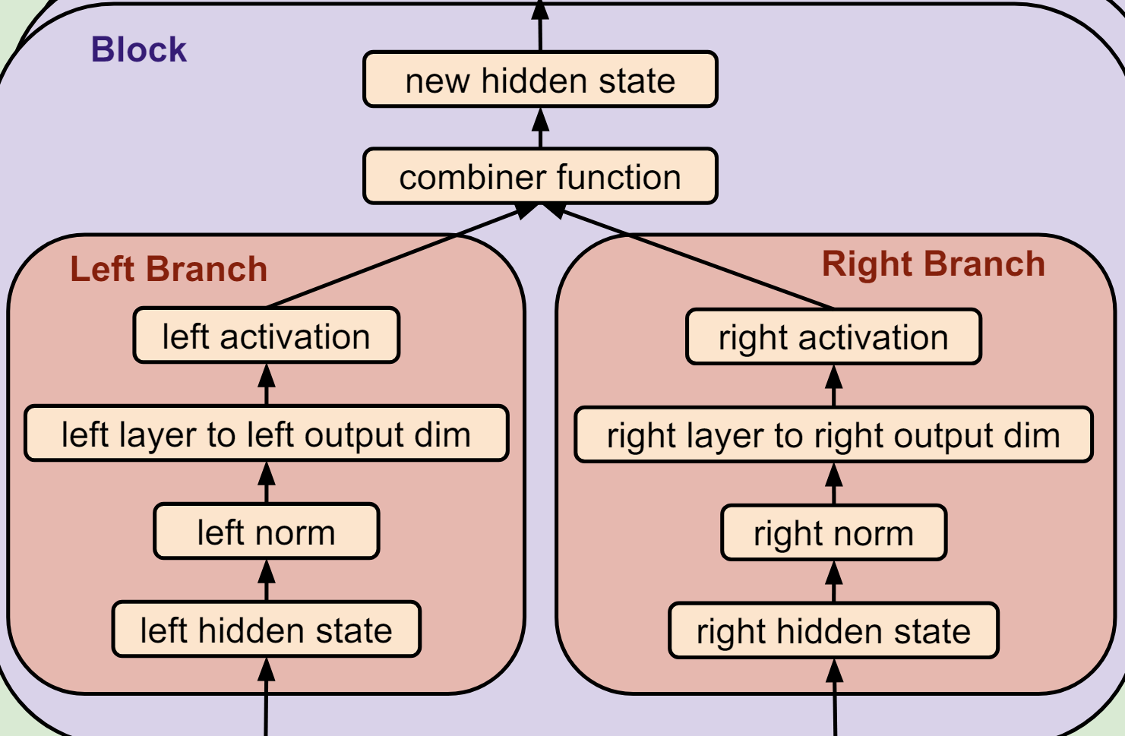
The Evolved Transformer: Search Space
Image: (So et al., 2019)
Notes:
The core of the search space is the block. each block is then divided in two branch(left and tight). each branch receives different input data performn a different trasformation on it and then the two branch output are combined in one single block output.

Slide 24
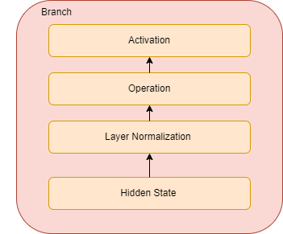
The Evolved Transformer: Search Space
Notes:
what kind of normalization is applied? layer normalization: for every data point calculate the mean and the sd and then to each point subtract mean of sd of the layer
should i say about output dimension? yes???
how are swish, relu and leaky relu activations?
hidden state: vary form
is the cell input the output of the last cell? yes, i think so
gated linear unit: GLU(X)=(XW+b)⊙σ(XV+c) sigma is sigmoid activation function element-wise multiplication. two separate linear transformations on the input data matrix using two different sets of weights, followed by a gating mechanism

Slide 25
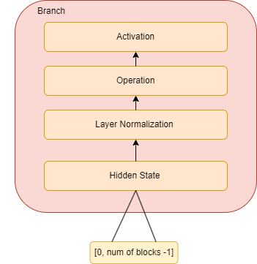
The Evolved Transformer: Search Space
Notes:
what kind of normalization is applied? layer normalization: for every data point calculate the mean and the sd and then to each point subtract mean of sd of the layer
should i say about output dimension? yes???
how are swish, relu and leaky relu activations?
hidden state: vary form
is the cell input the output of the last cell? yes, i think so
gated linear unit: GLU(X)=(XW+b)⊙σ(XV+c) sigma is sigmoid activation function element-wise multiplication. two separate linear transformations on the input data matrix using two different sets of weights, followed by a gating mechanism

Slide 26
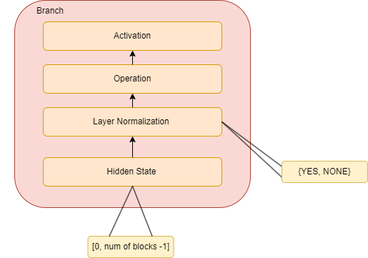
The Evolved Transformer: Search Space
Notes:
what kind of normalization is applied? layer normalization: for every data point calculate the mean and the sd and then to each point subtract mean of sd of the layer
should i say about output dimension? yes???
how are swish, relu and leaky relu activations?
hidden state: vary form
is the cell input the output of the last cell? yes, i think so
gated linear unit: GLU(X)=(XW+b)⊙σ(XV+c) sigma is sigmoid activation function element-wise multiplication. two separate linear transformations on the input data matrix using two different sets of weights, followed by a gating mechanism

Slide 27
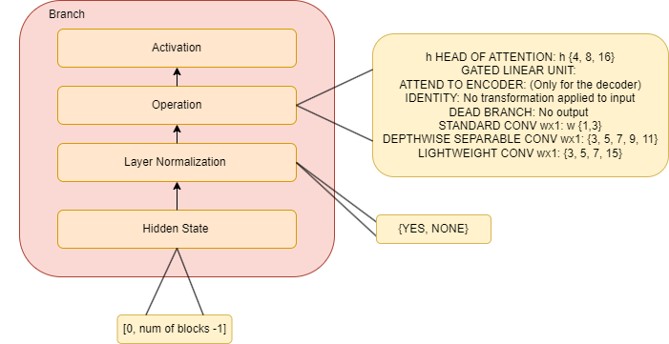
The Evolved Transformer: Search Space
Notes:
what kind of normalization is applied? layer normalization: for every data point calculate the mean and the sd and then to each point subtract mean of sd of the layer
should i say about output dimension? yes???
how are swish, relu and leaky relu activations?
hidden state: vary form
is the cell input the output of the last cell? yes, i think so
gated linear unit: GLU(X)=(XW+b)⊙σ(XV+c) sigma is sigmoid activation function element-wise multiplication. two separate linear transformations on the input data matrix using two different sets of weights, followed by a gating mechanism

Slide 28
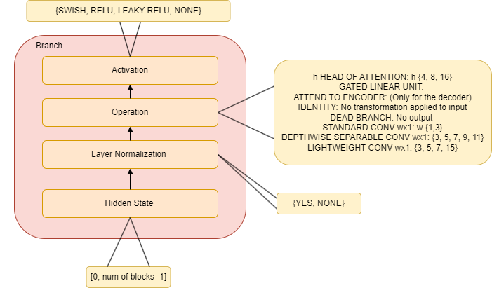
The Evolved Transformer: Search Space
Notes:
what kind of normalization is applied? layer normalization: for every data point calculate the mean and the sd and then to each point subtract mean of sd of the layer
should i say about output dimension? yes???
how are swish, relu and leaky relu activations?
hidden state: vary form
is the cell input the output of the last cell? yes, i think so
gated linear unit: GLU(X)=(XW+b)⊙σ(XV+c) sigma is sigmoid activation function element-wise multiplication. two separate linear transformations on the input data matrix using two different sets of weights, followed by a gating mechanism

Slide 29

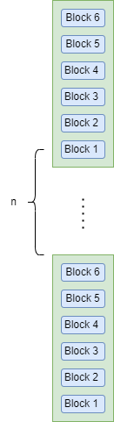
The Evolved Transformer: Search Space
For each block:
Combiner Function: {Addition, Concatenation, Multiplication}
For each cell:
Number of cells: [1, 6]
Top: (So et al., 2019)
Notes:
in total the search space is
space of 7,30*10^115 models but they do shrink it→ discard all architectures where the decoder does not have at least 1:attend to the encoder. but this seems to not be present in the fina ET decoder cell, also they basically always enforce the

Slide 30
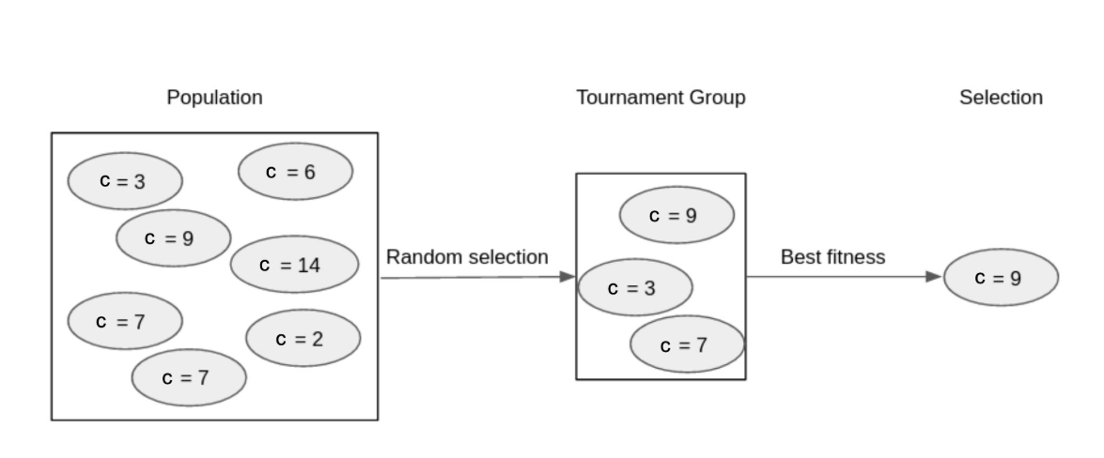
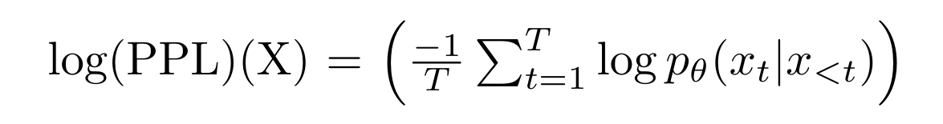
The Evolved Transformer: Search Strategy
Search strategy:
Evolutionary Algorithm
Tournament Selection
Fitness metric: Log-perplexity
Image: Automated Machine Learning - Prof. Marius Lindauer, Prof. Frank Hutter, Prof. Bernd Bischl, Prof. Lars Kotthoff
Notes:
X is a matrix of tokens xi
and noew that we have introduced the search space of the evolved transformer we will now describe the novel EA algorithm used as search strategy.
as search strategy the authors used evolutionary algorithms with tournament selection. tournament selection means that when choosing the next parent generation we randomly choose k architecteurs and choose the one with the highest fitness metric, in this case is log perplexity on the WMT’14 En-De validation set.
(Perplexity is a metric used to evaluate the performance of language models. It essentially measures how well a model predicts the next word in a sequence. A lower perplexity score indicates better performance.)
why log perplexity? more consistent result and helped reduce noise of fitness(?????) andom fluctuations in their evaluation metric

Slide 31
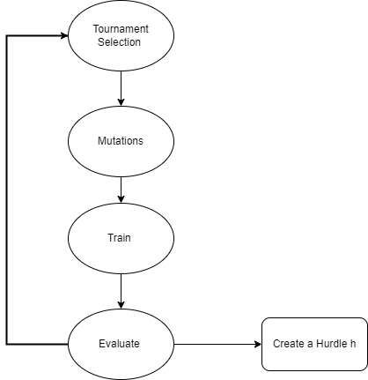


The Evolved Transformer: Search Strategy
Progressive Dynamic Hurdles(PDH):
EA that allocates resources to more promising architectures
Notes:
EA with warms starting: strong defal configuration for the EA's hyperparameters)
but given the complexty of the task at end authors had to adopt neew solutons to speed up the raining and they introduced a novel evolutionary algorithm whichdynam ically allocate resources to more promising architectures according to their fitness. aclled Progressive Dynammic Hurdles(PDH)
when do we create a hurdle? after a number of models is being evaluated m= 5000, the models are allowed to train for s= 60, 60, 120. the number of epochs they are allowed to train increases with time
what training used for the NN? I assume SGD but it wasnt specified
population size of 100 to select the parents??
question: how many training steps in the PDH, how many models evaluated?
they did run some ablation studies on not using PDH but a normal EA and also with and withou seeding the population with the transformer, and the best result was with the PDH and seeing with the transformer in terms of perplexity. each of these ablation studies was run 3 times
they did use Google TPUV.2 to train during EA, but then they trained the architecture from scratch on a different architecture 8 NVIDIA 100

Slide 32
The Evolved Transformer: Search Strategy
Summary of Progressive Dynamic Hurdle(PDH):
Optimize training efficiency
Increasing difficulty gradually
Avoids wasting resources
Notes:
by focusing training time on potentially good architectures.
Gradually increases training difficulty, allowing promising models to reach their full potential.
Avoids wasting resources on poorly performing models
question: a little bit more on the training of the PDH, like for how much more were the good performing architecture allowed to train?
they wanted to approximate the 300k training step of the big transformer and they used 240k

Slide 33
The Evolved Transformer: Datasets
Two tasks:
Machine Translation
WMT’18 En-De
WMT’14 En-Fr
WMT’18 En-Cs
Language Modeling
1 Billion Word Language Model Benchmark (LM1B)
Notes:
Train for 300k steps on a single Google TPU V.2 chip
machine translation: literally what it sounds
WMT: large language pair sentences in the two target languages
LM1B: 1 billion words sourced from various news article
language modeling: next word prediction
the WMTì18 En-De dataset was used to train, but then it also tested again the other datasets

Slide 34
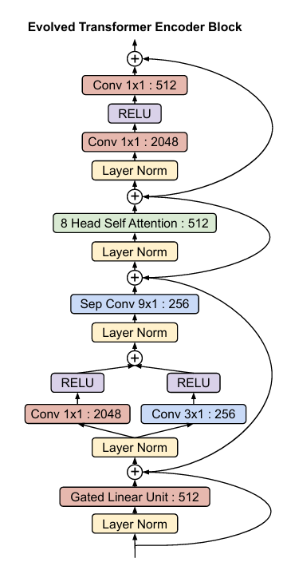
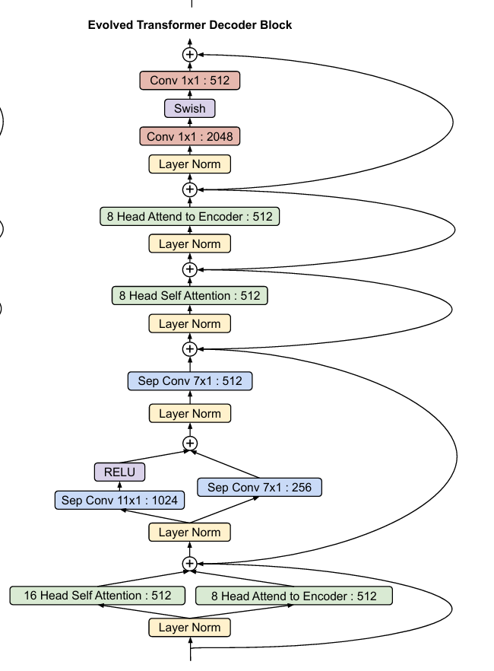
The Evolved Transformer: Architecture
The Evolved Transformer Encoder Cell
The Evolved Transformer Decoder Cell
Image: (So et al., 2019)
Notes:
and after training this for a while on two tasks
they they selected the top 20models and retrain them from scratch and then used the best model perplexity. so they trained on each dataset, and for each of this found the top 20 models, retrain them from scratch and among all these(20*4= 80) models they just choose the best one
final comparison run on the same 8 NVIDIA P100 hardware setup that was used by Vaswani et al
how can they come up with just a final architecture with 4 different training dataset?
the block is the cell
they basically used the right branch to encode the skipped connections
3 encoder cells and 4 decoder cells but who knows

Slide 35
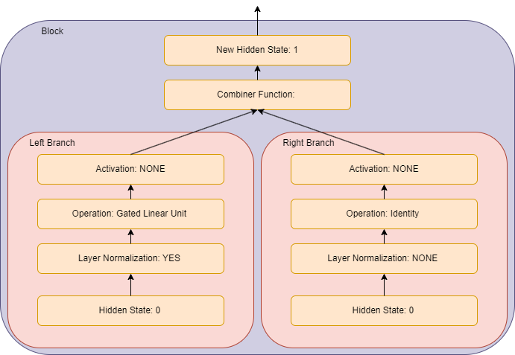
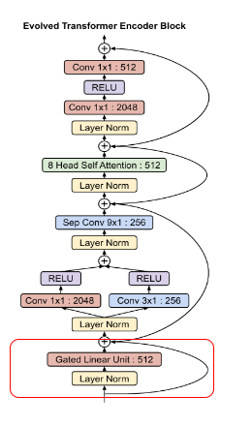
The Evolved Transformer: Architecture
The Evolved Transformer Encoder Cell
Image: (So et al., 2019)
Notes:
Left: layer normalization is applied aiapplies a Gated linear unit transformation, which basically is the element wise multiplication between a linear transformation of the input and an activation function applied to the input, no activation is used
Right: No layer normalization, no transformation is applied to the input, no activation
Combiner function not specified in the paper, my intuition from the plus is that it is addition
but we can kinda think of the right branch like encoding a skipped connection
. Any unused hidden states are automatically added to the final block output via addition.
how did they combined the different dimensions: For MULTIPLICATION and ADDITION, if the right and left branch outputs have differing embedding depths, then the smaller of the two is padded so that the dimensionality matches. For ADDITION the padding is 0’s; for MULTIPLI CATION the padding is 1’s.
my doubt: RELU does not change the dimensionality, so something must be happening here, but the combiner function cannot be null value soooo
there is an extra “operation” to be decided and it is the output dimension after the operation, there are 10 choices which depend on the different operation(10 different relative dimensions)to adjust the sizes of the operation

Slide 36
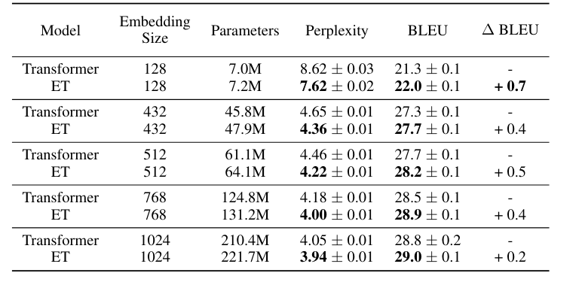
The Evolved Transformer: Results
WMT’14En-De Dataset
Validation Dataset
Test Dataset
Table: (So et al., 2019)
Notes:
which dataset is this? WMT’14En-De it is also the main dataset used in the original transformer
did they retrain the all architecture from scratch? yes
Across various embedding sizes (128 to 1024), the Evolved Transformer consistently shows improvements in **Perplexity** and **BLEU** scores compared to the standard Transformer. This suggests that the architectural enhancements introduced by ET through Neural Architecture Search (NAS) contribute to better performance without excessively increasing computational demands.
The improvements shown by ET are consistent across various hardware configurations (432 to 1024 embedding sizes), indicating robustness in performance enhancements across different scales of computational resources.
BLUE: valuate the quality of machine-generated translations against human-generated reference translations.
is better high, perplexiy low. showing the difference in BLEU since it is also what is shown in the original
why different embedding sizes? To create a spectrum of model sizes for each architecture the authors selected different input embedding sizes and shrank or grew the rest of the model embedding sizes with the same proportions and the embedding size of course influence the number of parameters in the model: the number of embedding layer for tokens (word embeddings) and positions (positional embeddings)

Slide 37
The Evolved Transformer: Results
WMT’14En-De Dataset
Validation Dataset
Test Dataset
Table: (So et al., 2019)
Notes:
which dataset is this? WMT’14En-De it is also the main dataset used in the original transformer
did they retrain the all architecture from scratch? yes
explain how they have created model with different sizes
Across various embedding sizes (128 to 1024), the Evolved Transformer consistently shows improvements in **Perplexity** and **BLEU** scores compared to the standard Transformer. This suggests that the architectural enhancements introduced by ET through Neural Architecture Search (NAS) contribute to better performance without excessively increasing computational demands.
The improvements shown by ET are consistent across various hardware configurations (432 to 1024 embedding sizes), indicating robustness in performance enhancements across different scales of computational resources.
BLUE: valuate the quality of machine-generated translations against human-generated reference translations.
is better high, perplexiy low. showing the difference in BLEU since it is also what is shown in the original
why different embedding sizes? To create a spectrum of model sizes for each architecture the authors selected different input embedding sizes and shrank or grew the rest of the model embedding sizes with the same proportions and the embedding size of course influence the number of parameters in the model: the number of embedding layer for tokens (word embeddings) and positions (positional embeddings)

Slide 38
The Evolved Transformer: Results
WMT’14En-De Dataset
Validation Dataset
Test Dataset
Table: (So et al., 2019)
Notes:
which dataset is this? WMT’14En-De it is also the main dataset used in the original transformer
did they retrain the all architecture from scratch? yes
Across various embedding sizes (128 to 1024), the Evolved Transformer consistently shows improvements in **Perplexity** and **BLEU** scores compared to the standard Transformer. This suggests that the architectural enhancements introduced by ET through Neural Architecture Search (NAS) contribute to better performance without excessively increasing computational demands.
The improvements shown by ET are consistent across various hardware configurations (432 to 1024 embedding sizes), indicating robustness in performance enhancements across different scales of computational resources.
BLUE: valuate the quality of machine-generated translations against human-generated reference translations.
is better high, perplexiy low. showing the difference in BLEU since it is also what is shown in the original
why different embedding sizes? To create a spectrum of model sizes for each architecture the authors selected different input embedding sizes and shrank or grew the rest of the model embedding sizes with the same proportions and the embedding size of course influence the number of parameters in the model: the number of embedding layer for tokens (word embeddings) and positions (positional embeddings)

Slide 39
The Evolved Transformer: Results
WMT’14En-De Dataset
Validation Dataset
Test Dataset
Table: (So et al., 2019)
Notes:
which dataset is this? WMT’14En-De it is also the main dataset used in the original transformer
did they retrain the all architecture from scratch? yes
Across various embedding sizes (128 to 1024), the Evolved Transformer consistently shows improvements in **Perplexity** and **BLEU** scores compared to the standard Transformer. This suggests that the architectural enhancements introduced by ET through Neural Architecture Search (NAS) contribute to better performance without excessively increasing computational demands.
The improvements shown by ET are consistent across various hardware configurations (432 to 1024 embedding sizes), indicating robustness in performance enhancements across different scales of computational resources.
they authors suggest that using data augmentation techniques could help ET achieving a better performance at big model sizes
BLUE: valuate the quality of machine-generated translations against human-generated reference translations.
is better high, perplexiy low. showing the difference in BLEU since it is also what is shown in the original
why different embedding sizes? To create a spectrum of model sizes for each architecture the authors selected different input embedding sizes and shrank or grew the rest of the model embedding sizes with the same proportions and the embedding size of course influence the number of parameters in the model: the number of embedding layer for tokens (word embeddings) and positions (positional embeddings)

Slide 40
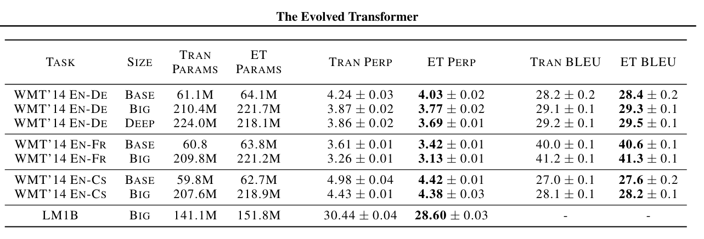
The Evolved Transformer: Results
Validation Dataset
Test Dataset
Table: (So et al., 2019)
Notes:
perplexity on the validation set
BLUE on the test set
and now this are the results on the other WMT datasets and on the LM1B datasets
we can still see that for different parameters sizes the ET still systematically performs better than the original transformer, also on the language modeling task of the LM1B datasets
also here more difference at lower parameter sizes
not so much difference at bigger model sizes→ models tend to overfit and the authors mention again that using data augmentation or hyperparamter optimization could alleviate this
but they used the WMTEN-De paper to train the architectures on the EA, to also train the 20 top model from scratch and they they use the validation and test set of WMT to show the results→ kinda bad
what the BASE→ 512 , BIG→ 1024 and DEEP→ the original DEEP, means embedding depth of 640, ET 9 enc, 10 dec T: 768, 6 enc 6 dec
also in the original vaswani et al paper base has embedding size 512 6 enc 6 dec and big has embedding size 1024

Slide 41
The Evolved Transformer: Results
Validation Dataset
Test Dataset
Table: (So et al., 2019)
Notes:
perplexity on the validation set
BLUE on the test set
and now this are the results on the other WMT datasets and on the LM1B datasets
we can still see that for different parameters sizes the ET still systematically performs better than the original transformer, also on the language modeling task of the LM1B datasets
also here more difference at lower parameter sizes
not so much difference at bigger model sizes→ models tend to overfit and the authors mention again that using data augmentation or hyperparamter optimization could alleviate this
but they used the WMTEN-De paper to train the architectures on the EA, to also train the 20 top model from scratch and they they use the validation and test set of WMT to show the results→ kinda bad
what the BASE→ 512 , BIG→ 1024 and DEEP→ not really specified, also deep ET has less parameters than big
also in the original vaswani et al paper base has embedding size 512 and big has embedding size 1024

Slide 42
The Evolved Transformer: Summary
Novel Search Space
Progressive Dynamic Hurdle
Consistent improvement on Language Tasks
Notes:
While the Evolved Transformer has shown how NAS can be used to optimize generic transformer models, another significant development in this space is NAS-BERT, which specifically targets the BERT architecture

Slide 43
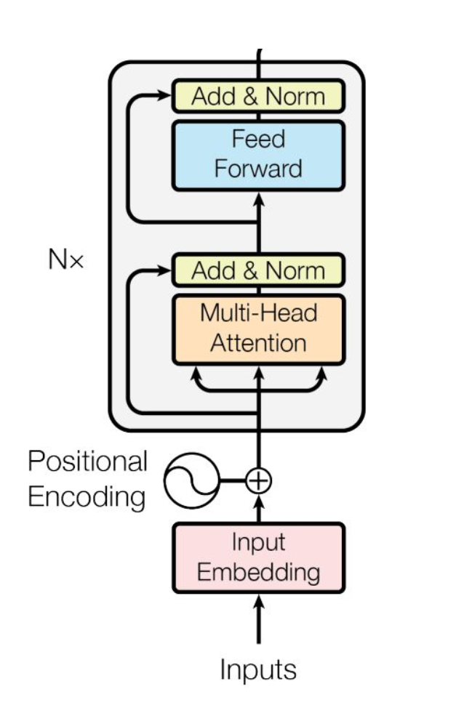
Transformers: BERT
BERT (Bidirectional Encoder Representations from Transformers) is a transformer-based model designed by Google
Multiple layers of Transformer encoders
BERT's ability to generate contextualized word embeddings has set new benchmarks for many NLP tasks
Image: (Vaswani et al., 2017)
Notes:
BERT (Bidirectional Encoder Representations from Transformers) is a transformer-based model designed for natural language processing (NLP) task
The architecture consists of multiple layers of bidirectional transformer encoders, which apply self-attention mechanisms to capture intricate patterns and relationships in the text. BERT's pre-training involves two tasks: masked language modeling (predicting masked words in a sentence) and next sentence prediction (understanding the relationship between sentence pairs)

Slide 44
NAS-BERT
HW-NAS
Goal of NAS-BERT:
Efficient task-agnostic BERT models with different size and hardware constraints
Image: (Vaswani et al., 2017)
Notes:
While the Evolved Transformer has shown how NAS can be used to optimize generic transformer models, another significant development in this space is NAS-BERT, which specifically targets the BERT architecture.
**Complexity:** BERT's architecture is highly complex and resource-intensive, making manual optimization challenging.
- **Computational Cost:** High computational and memory requirements hinder its deployment in resource-constrained environments.
bert complexity: bert base has 110million para and bert large has 340 million paramters
and how has this been done?
explain this overall idea better: The NAS algorithm needs to generate multiple models with varying sizes and latencies to accommodate devices with different memory and latency limitations, but this models should be task-agnostic, so not tailored for any specific NLP task

Slide 45
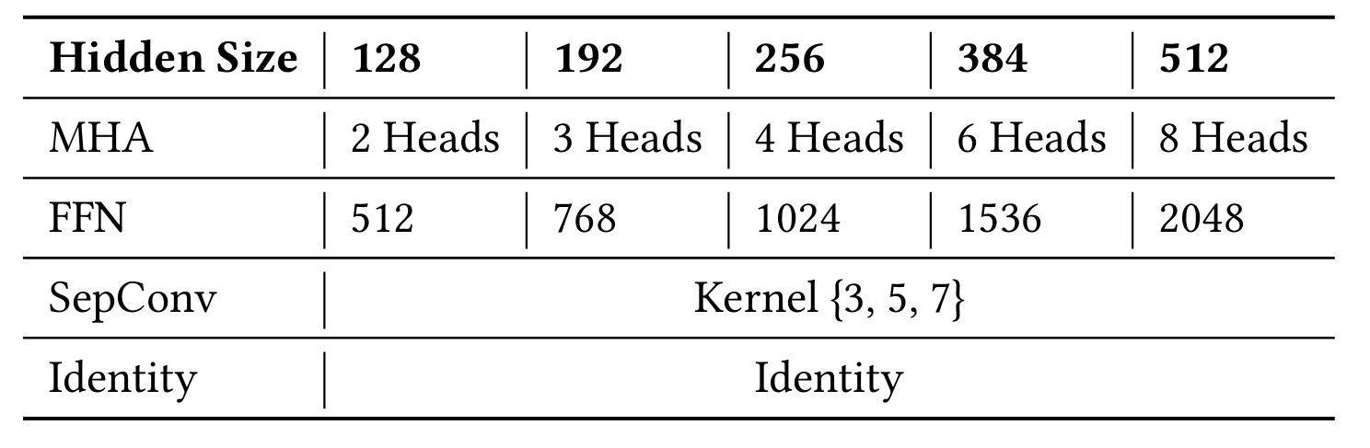
NAS-BERT: Search Space
Chain Structure
Operations:
Table: (Xu et al., 2021)
Notes:
Identity operation is regarded as a placeholder in a candidate architecture and can be removed to obtain a shallower network.

Slide 46
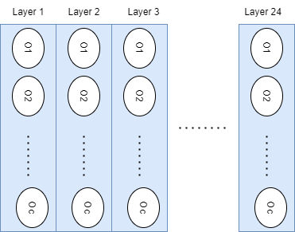
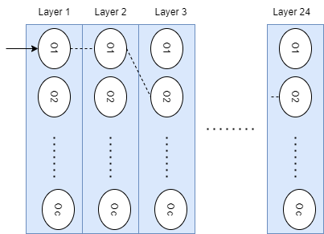
NAS-BERT: Search Space
One shot models
Notes:
24 layers
26 operations in total???

Slide 47
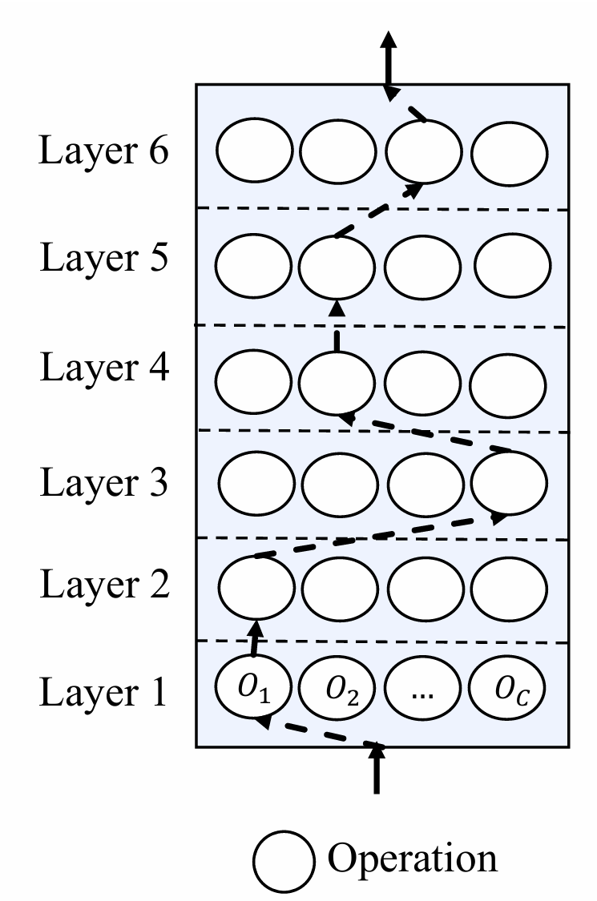
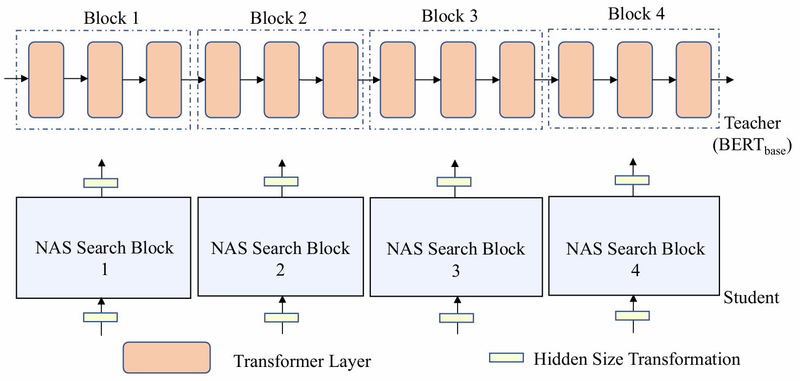
NAS-BERT: Training
Block wise search:
N = 4 blocks each with 6 layers
Knowledge distillation
Progressive shrinking
Hardware constraint:
Latency
Images: (Xu et al., 2021)
Notes:
advantage of block wise search in speeding up training gradient just inside the block, instead of optimizing all architectures at the same time. once you find the optimal architecture in one block you can sto the search, the blocks are easli parallelizable.
TEACHER: BERT BASE pretrained on wikipedia corpus
. progressive shriking: drop out architecture with the worst validation loss based on treshold
the student has the same training configuration as the teacher model BERT BASE which was trained using adam
The training costs of NAS BERT was 3 days on 32 NVIDIA P40 GPUs while training the BERT base teacher model costs 5d ays
the all architecture is then composed of all the layers together
not specified in which time unit latency is measured seconds or milliseconds

Slide 48
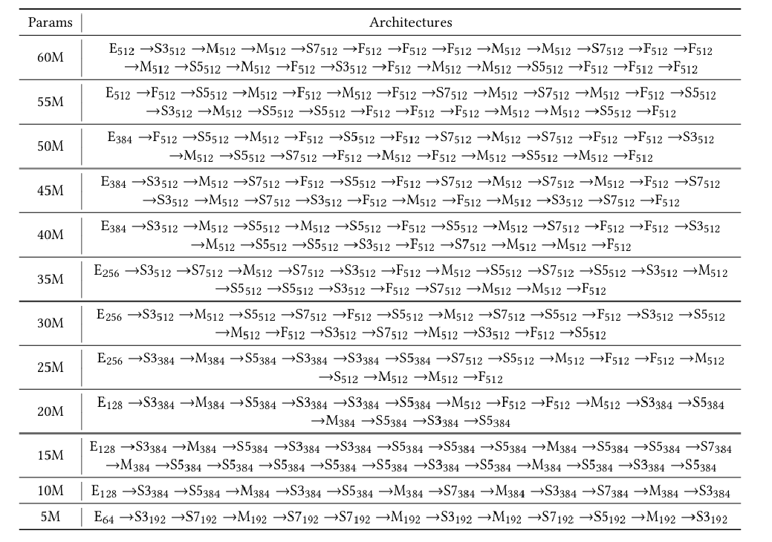
NAS-BERT: Architecture
E: Embedding
M: MHA
F: FFN
Sn: Separable Convolution
with kernel n
Notes:
10M and 5M have same operations but different hidden sizes and different kernels for the separable convolution
expect for the initial embedding size of 30M and 60M both always use an embedding size of 512 in the all architecture, but the 60M ones has more operations.
but how can we have less operations if in total 24 layers in the supernetwork? identity layer can be dropped
TODO: legenda
modify image
prova a dire le nuove slides
migliora spiegazione NAS
prepara slides risposta

Slide 49
NAS-BERT: Architecture
E: Embedding
M: MHA
F: FFN
Sn: Separable Convolution
with kernel n
Notes:
10M and 5M have same operations but different hidden sizes and different kernels for the separable convolution
expect for the initial embedding size of 30M and 60M both always use an embedding size of 512 in the all architecture, but the 60M ones has more operations.
but how can we have less operations if in total 24 layers in the supernetwork? identity layer can be dropped
TODO: legenda
modify image
prova a dire le nuove slides
migliora spiegazione NAS
prepara slides risposta

Slide 50
NAS-BERT: Architecture
E: Embedding
M: MHA
F: FFN
Sn: Separable Convolution
with kernel n
Notes:
10M and 5M have same operations but different hidden sizes and different kernels for the separable convolution
expect for the initial embedding size of 30M and 60M both always use an embedding size of 512 in the all architecture, but the 60M ones has more operations.
but how can we have less operations if in total 24 layers in the supernetwork? identity layer can be dropped
TODO: legenda
modify image
prova a dire le nuove slides
migliora spiegazione NAS
prepara slides risposta

Slide 51
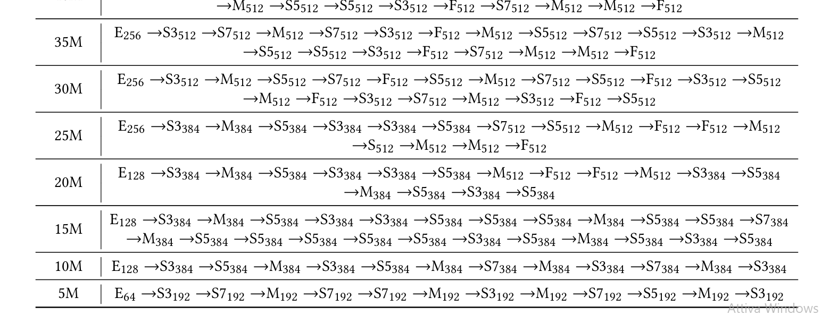
NAS-BERT: Architecture
E: Embedding
M: MHA
F: FFN
Sn: Separable Convolution
with kernel n
Notes:
10M and 5M have same operations but different hidden sizes and different kernels for the separable convolution
expect for the initial embedding size of 30M and 60M both always use an embedding size of 512 in the all architecture, but the 60M ones has more operations.
but how can we have less operations if in total 24 layers in the supernetwork? identity layer can be dropped
TODO: legenda
modify image
prova a dire le nuove slides
migliora spiegazione NAS
prepara slides risposta

Slide 52
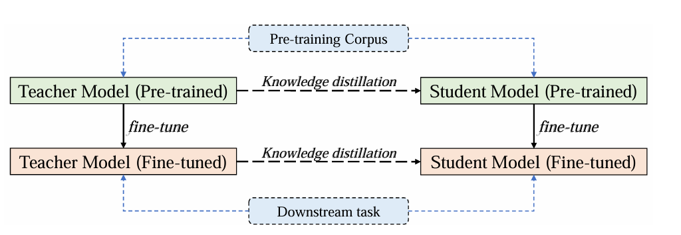
NAS-BERT: Model Selection
Look up table:
Architecture, number of parameters, latency, loss
Retrain with two stage knowledge distillation the best architecture
Dataset: English Wikipedia and Book Corpus
Fine-tuning
GLUE and SQuAD
Image: (Xu et al., 2021)
Notes:
what loooosss: mean squared loss
then when retrained from zero cross entropy loss
supernet trainied
nglishWikipedia BookCorpus: task language modeling
GLUE tasks: sentence, entence understanding: Determining the relationship between two sentences (e.g., entailment, contradiction, neutrality). (Examples: MNLI, QNLI, RTE, WNLI)
Similarity and Paraphrasing: Measuring the semantic similarity between sentences or questions. (Examples: MRPC, STS-B, QQP)
Natural Language Inference (NLI): Determining if a hypothesis can be inferred from a given premise. (Examples: MNLI, QNLI, RTE)
Single-sentence tasks: Analyzing the sentiment or opinion expressed in a single sentence. (Examples: CoLA, SST-2)
SQuAD: question answering
3 days of training NAS BERT 5days for the BERT base teacher model
HAVE A BETTER EXPLANATION FOR THIIIS
how did they choose the best model?
for a given constraint of model size and latency they select the top T=100 architectures with the best loss
for loss and latency they used performance approximation
when retraining the best model again we use a variant of KD: two stage knowledge distillation where we use knowledge distillation both in the training and finetuining phases.
General Language Understanding Evaluation(GLUE) benchmark
Purpose: Evaluate the performance of models on a diverse set of natural language understanding tasks

Slide 53
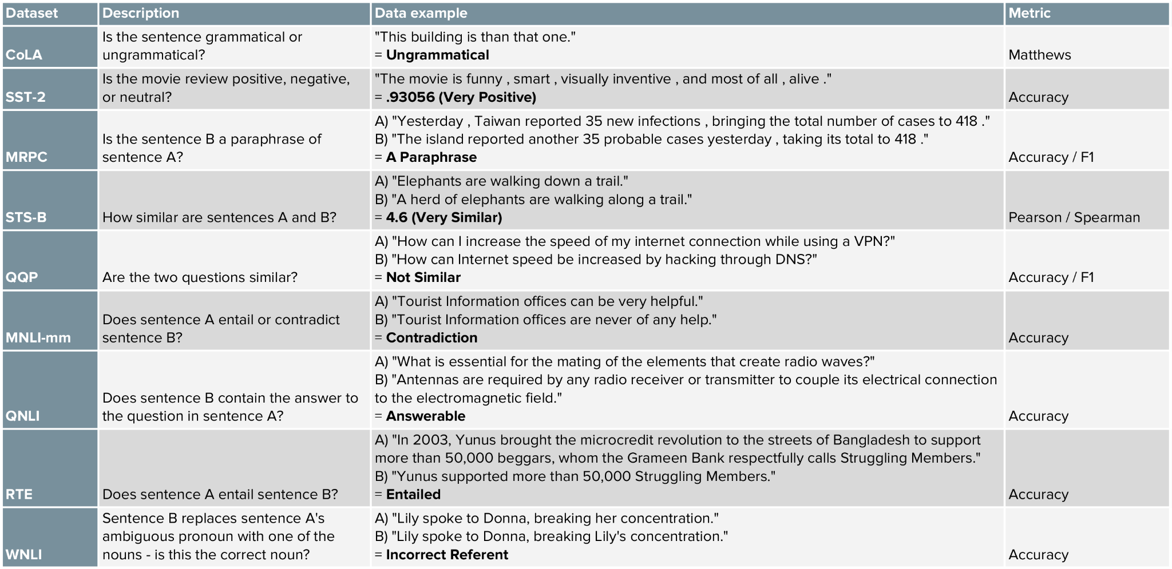
NAS-BERT: GLUE
General Language Understanding Evaluation (GLUE) benchmark
Table: https://mccormickml.com/2019/11/05/GLUE/
Notes:
General Language Understanding Evaluation (GLUE) benchmark is a collection of nine natural language understanding tasks, including single-sentence tasks CoLA and SST-2, similarity and paraphrasing tasks MRPC, STS-B and QQP, and natural language inference tasks MNLI, QNLI, RTE and WNLI.
The WMNLI dataset was not used in the NAS BERT case
CoLa: binary classification to determine whether a given sentence is grammatically acceptable
SST-2 sentiment classification
MRPC: Binary classification task to determine whether two sentences are paraphrases.
STS-B: Regression task to measure the similarity between two sentences on a scale of 1 to 5.
QQP: Binary classification task to determine whether two questions from Quora are paraphrases.
MNLI: Tree-way classification task to determine the relationship between a premise and a hypothesis (entailment, contradiction, or neutral).
QNLI: inary classification task to determine whether a context sentence contains the answer to a given question.
RTE: Binary classification task to determine whether a given premise entails a given hypothesis.
WNLI: Binary classification task to determine the antecedent of an ambiguous pronoun in a sentence. entails: If the premise is true, the hypothesis must be true
Premise: "The cat is on the mat."
Hypothesis: "There is a cat on the mat."
Relationship: The premise entails the hypothesis.

Slide 54
NAS-BERT: GLUE
General Language Understanding Evaluation (GLUE) benchmark
Table: https://mccormickml.com/2019/11/05/GLUE/
Notes:
General Language Understanding Evaluation (GLUE) benchmark is a collection of nine natural language understanding tasks, including single-sentence tasks CoLA and SST-2, similarity and paraphrasing tasks MRPC, STS-B and QQP, and natural language inference tasks MNLI, QNLI, RTE and WNLI.
The WMNLI dataset was not used in the NAS BERT case
CoLa: binary classification to determine whether a given sentence is grammatically acceptable
SST-2 sentiment classification
MRPC: Binary classification task to determine whether two sentences are paraphrases.
STS-B: Regression task to measure the similarity between two sentences on a scale of 1 to 5.
QQP: Binary classification task to determine whether two questions from Quora are paraphrases.
MNLI: Tree-way classification task to determine the relationship between a premise and a hypothesis (entailment, contradiction, or neutral).
QNLI: inary classification task to determine whether a context sentence contains the answer to a given question.
RTE: Binary classification task to determine whether a given premise entails a given hypothesis.
WNLI: Binary classification task to determine the antecedent of an ambiguous pronoun in a sentence. entails: If the premise is true, the hypothesis must be true
Premise: "The cat is on the mat."
Hypothesis: "There is a cat on the mat."
Relationship: The premise entails the hypothesis.

Slide 55
NAS-BERT: GLUE
General Language Understanding Evaluation (GLUE) benchmark
Table: https://mccormickml.com/2019/11/05/GLUE/
Notes:
General Language Understanding Evaluation (GLUE) benchmark is a collection of nine natural language understanding tasks, including single-sentence tasks CoLA and SST-2, similarity and paraphrasing tasks MRPC, STS-B and QQP, and natural language inference tasks MNLI, QNLI, RTE and WNLI.
The WMNLI dataset was not used in the NAS BERT case
CoLa: binary classification to determine whether a given sentence is grammatically acceptable
SST-2 sentiment classification
MRPC: Binary classification task to determine whether two sentences are paraphrases.
STS-B: Regression task to measure the similarity between two sentences on a scale of 1 to 5.
QQP: Binary classification task to determine whether two questions from Quora are paraphrases.
MNLI: Tree-way classification task to determine the relationship between a premise and a hypothesis (entailment, contradiction, or neutral).
QNLI: inary classification task to determine whether a context sentence contains the answer to a given question.
RTE: Binary classification task to determine whether a given premise entails a given hypothesis.
WNLI: Binary classification task to determine the antecedent of an ambiguous pronoun in a sentence. entails: If the premise is true, the hypothesis must be true
Premise: "The cat is on the mat."
Hypothesis: "There is a cat on the mat."
Relationship: The premise entails the hypothesis.

Slide 56
NAS-BERT: GLUE
General Language Understanding Evaluation (GLUE) benchmark
Table: https://mccormickml.com/2019/11/05/GLUE/
Notes:
General Language Understanding Evaluation (GLUE) benchmark is a collection of nine natural language understanding tasks, including single-sentence tasks CoLA and SST-2, similarity and paraphrasing tasks MRPC, STS-B and QQP, and natural language inference tasks MNLI, QNLI, RTE and WNLI.
The WMNLI dataset was not used in the NAS BERT case
CoLa: binary classification to determine whether a given sentence is grammatically acceptable
SST-2 sentiment classification
MRPC: Binary classification task to determine whether two sentences are paraphrases.
STS-B: Regression task to measure the similarity between two sentences on a scale of 1 to 5.
QQP: Binary classification task to determine whether two questions from Quora are paraphrases.
MNLI: Tree-way classification task to determine the relationship between a premise and a hypothesis (entailment, contradiction, or neutral).
QNLI: inary classification task to determine whether a context sentence contains the answer to a given question.
RTE: Binary classification task to determine whether a given premise entails a given hypothesis.
WNLI: Binary classification task to determine the antecedent of an ambiguous pronoun in a sentence. entails: If the premise is true, the hypothesis must be true
Premise: "The cat is on the mat."
Hypothesis: "There is a cat on the mat."
Relationship: The premise entails the hypothesis.

Slide 57
NAS-BERT: GLUE
General Language Understanding Evaluation (GLUE) benchmark
Table: https://mccormickml.com/2019/11/05/GLUE/
Notes:
General Language Understanding Evaluation (GLUE) benchmark is a collection of nine natural language understanding tasks, including single-sentence tasks CoLA and SST-2, similarity and paraphrasing tasks MRPC, STS-B and QQP, and natural language inference tasks MNLI, QNLI, RTE and WNLI.
The WMNLI dataset was not used in the NAS BERT case
CoLa: binary classification to determine whether a given sentence is grammatically acceptable
SST-2 sentiment classification
MRPC: Binary classification task to determine whether two sentences are paraphrases.
STS-B: Regression task to measure the similarity between two sentences on a scale of 1 to 5.
QQP: Binary classification task to determine whether two questions from Quora are paraphrases.
MNLI: Tree-way classification task to determine the relationship between a premise and a hypothesis (entailment, contradiction, or neutral).
QNLI: inary classification task to determine whether a context sentence contains the answer to a given question.
RTE: Binary classification task to determine whether a given premise entails a given hypothesis.
WNLI: Binary classification task to determine the antecedent of an ambiguous pronoun in a sentence. entails: If the premise is true, the hypothesis must be true
Premise: "The cat is on the mat."
Hypothesis: "There is a cat on the mat."
Relationship: The premise entails the hypothesis.

Slide 58
NAS-BERT: GLUE
General Language Understanding Evaluation (GLUE) benchmark
Table: https://mccormickml.com/2019/11/05/GLUE/
Notes:
General Language Understanding Evaluation (GLUE) benchmark is a collection of nine natural language understanding tasks, including single-sentence tasks CoLA and SST-2, similarity and paraphrasing tasks MRPC, STS-B and QQP, and natural language inference tasks MNLI, QNLI, RTE and WNLI.
The WMNLI dataset was not used in the NAS BERT case
CoLa: binary classification to determine whether a given sentence is grammatically acceptable
SST-2 sentiment classification
MRPC: Binary classification task to determine whether two sentences are paraphrases.
STS-B: Regression task to measure the similarity between two sentences on a scale of 1 to 5.
QQP: Binary classification task to determine whether two questions from Quora are paraphrases.
MNLI: Tree-way classification task to determine the relationship between a premise and a hypothesis (entailment, contradiction, or neutral).
QNLI: inary classification task to determine whether a context sentence contains the answer to a given question.
RTE: Binary classification task to determine whether a given premise entails a given hypothesis.
WNLI: Binary classification task to determine the antecedent of an ambiguous pronoun in a sentence. entails: If the premise is true, the hypothesis must be true
Premise: "The cat is on the mat."
Hypothesis: "There is a cat on the mat."
Relationship: The premise entails the hypothesis.

Slide 59
NAS-BERT: GLUE
General Language Understanding Evaluation (GLUE) benchmark
Table: https://mccormickml.com/2019/11/05/GLUE/
Notes:
General Language Understanding Evaluation (GLUE) benchmark is a collection of nine natural language understanding tasks, including single-sentence tasks CoLA and SST-2, similarity and paraphrasing tasks MRPC, STS-B and QQP, and natural language inference tasks MNLI, QNLI, RTE and WNLI.
The WMNLI dataset was not used in the NAS BERT case
CoLa: binary classification to determine whether a given sentence is grammatically acceptable
SST-2 sentiment classification
MRPC: Binary classification task to determine whether two sentences are paraphrases.
STS-B: Regression task to measure the similarity between two sentences on a scale of 1 to 5.
QQP: Binary classification task to determine whether two questions from Quora are paraphrases.
MNLI: Tree-way classification task to determine the relationship between a premise and a hypothesis (entailment, contradiction, or neutral).
QNLI: inary classification task to determine whether a context sentence contains the answer to a given question.
RTE: Binary classification task to determine whether a given premise entails a given hypothesis.
WNLI: Binary classification task to determine the antecedent of an ambiguous pronoun in a sentence. entails: If the premise is true, the hypothesis must be true
Premise: "The cat is on the mat."
Hypothesis: "There is a cat on the mat."
Relationship: The premise entails the hypothesis.

Slide 60
NAS-BERT: GLUE
General Language Understanding Evaluation (GLUE) benchmark
Table: https://mccormickml.com/2019/11/05/GLUE/
Notes:
General Language Understanding Evaluation (GLUE) benchmark is a collection of nine natural language understanding tasks, including single-sentence tasks CoLA and SST-2, similarity and paraphrasing tasks MRPC, STS-B and QQP, and natural language inference tasks MNLI, QNLI, RTE and WNLI.
The WMNLI dataset was not used in the NAS BERT case
CoLa: binary classification to determine whether a given sentence is grammatically acceptable
SST-2 sentiment classification
MRPC: Binary classification task to determine whether two sentences are paraphrases.
STS-B: Regression task to measure the similarity between two sentences on a scale of 1 to 5.
QQP: Binary classification task to determine whether two questions from Quora are paraphrases.
MNLI: Tree-way classification task to determine the relationship between a premise and a hypothesis (entailment, contradiction, or neutral).
QNLI: inary classification task to determine whether a context sentence contains the answer to a given question.
RTE: Binary classification task to determine whether a given premise entails a given hypothesis.
WNLI: Binary classification task to determine the antecedent of an ambiguous pronoun in a sentence. entails: If the premise is true, the hypothesis must be true
Premise: "The cat is on the mat."
Hypothesis: "There is a cat on the mat."
Relationship: The premise entails the hypothesis.

Slide 61
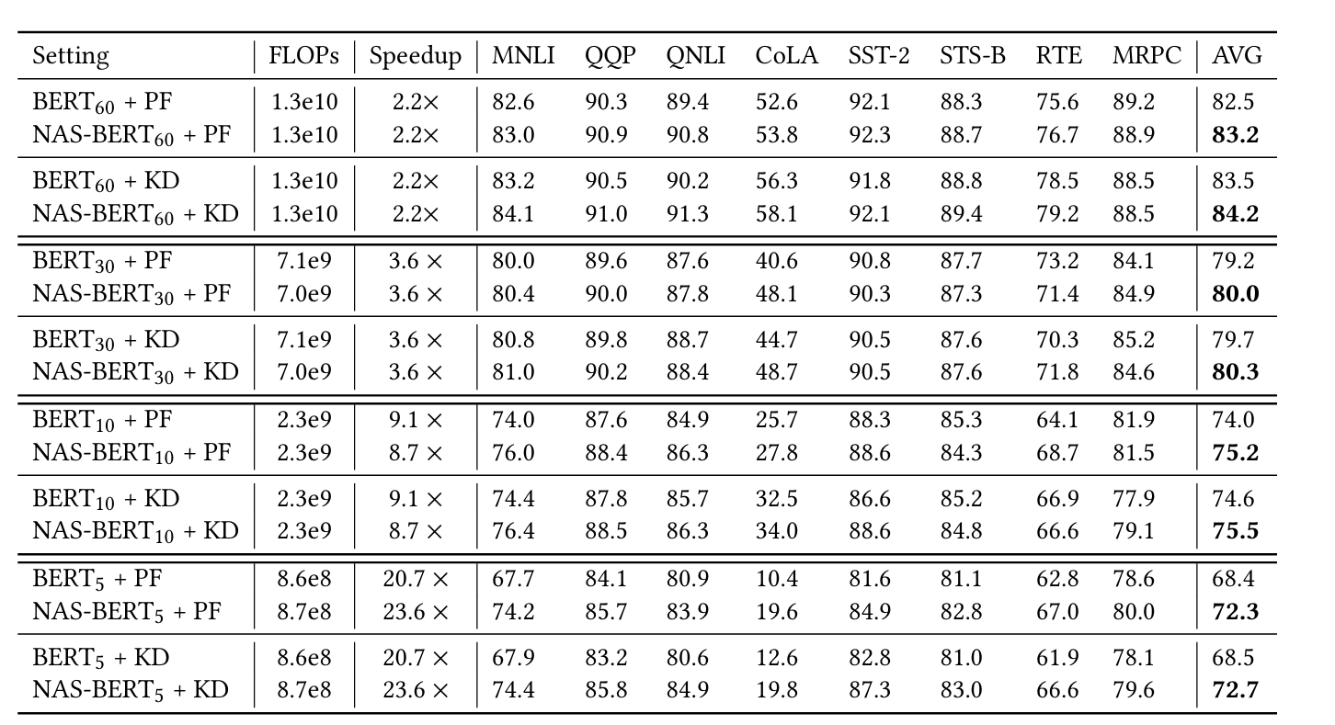
NAS-BERT: Results
GLUE validation set
Table: (Xu et al., 2021)
Notes:
Spearman correlation is reported for STS-B.
Matthew scorrelation is reported for CoLA .
Accuracy is reported for other tasks.
represents the average of the metrics that are shown in the table
the speed up are compared to The baseline BERT models in Table2 are: BERT60 (L=10,H=512,A=8),BERT30 (L=6,H=512,A=8),BERT10 (L=6,H=256,A=4)andBERT5(L=6,H=128,A=2)
but speed up in terms of what?? performance? latency? seconds? i think to run inference
These are different NLP dataset that are part of the GLUE benchmark
MNLI (Multi-Genre Natural Language Inference): This dataset tests a model's ability to understand the relationship between two sentences. It has three categories: entailment (one sentence implies the other), contradiction (one sentence contradicts the other), and neutral (no relationship between the sentences).
QQP (Quora Question Pairs): This dataset asks the model to identify whether two questions are semantically equivalent (asking the same thing) or not.
QNLI (Stanford Question Answering Natural Language Inference): to understand the relationship between a question and a passage. It focuses on whether the answer to the question can be found in the passage (entailment) or not.
CoLA (Corpus of Literature Annotations): This dataset is a simple task of sentiment analysis. The model needs to classify sentences as positive or negative.
SST-2 (Stanford Sentiment Treebank): Similar to CoLA, this dataset tests sentiment analysis, but with a finer grain. The model needs to classify sentences as positive, negative, or neutral.
STS-B (Semantic Text Similarity Benchmark): This dataset asks the model to judge the semantic similarity between two sentences. The model outputs a score between 0 (not similar) and 5 (highly similar).
RTE (Recognizing Textual Entailment): Similar to MNLI, this dataset tests a model's ability to understand the entailment relationship between two sentences. However, RTE uses different phrasing and focuses more on factual entailment.
MRPC (Microsoft Research Paraphrase Corpus): This dataset asks the model to identify whether two sentences express the same meaning (paraphrases) or not.

Slide 62
NAS-BERT: Results
GLUE validation set
Table: (Xu et al., 2021)
Notes:
Spearman correlation is reported for STS-B.
Matthew scorrelation is reported for CoLA .
Accuracy is reported for other tasks.
represents the average of the metrics that are shown in the table
the speed up are compared to The baseline BERT models in Table2 are: BERT60 (L=10,H=512,A=8),BERT30 (L=6,H=512,A=8),BERT10 (L=6,H=256,A=4)andBERT5(L=6,H=128,A=2)
but speed up in terms of what?? performance? latency? seconds? i think to run inference
These are different NLP dataset that are part of the GLUE benchmark
MNLI (Multi-Genre Natural Language Inference): This dataset tests a model's ability to understand the relationship between two sentences. It has three categories: entailment (one sentence implies the other), contradiction (one sentence contradicts the other), and neutral (no relationship between the sentences).
QQP (Quora Question Pairs): This dataset asks the model to identify whether two questions are semantically equivalent (asking the same thing) or not.
QNLI (Stanford Question Answering Natural Language Inference): to understand the relationship between a question and a passage. It focuses on whether the answer to the question can be found in the passage (entailment) or not.
CoLA (Corpus of Literature Annotations): This dataset is a simple task of sentiment analysis. The model needs to classify sentences as positive or negative.
SST-2 (Stanford Sentiment Treebank): Similar to CoLA, this dataset tests sentiment analysis, but with a finer grain. The model needs to classify sentences as positive, negative, or neutral.
STS-B (Semantic Text Similarity Benchmark): This dataset asks the model to judge the semantic similarity between two sentences. The model outputs a score between 0 (not similar) and 5 (highly similar).
RTE (Recognizing Textual Entailment): Similar to MNLI, this dataset tests a model's ability to understand the entailment relationship between two sentences. However, RTE uses different phrasing and focuses more on factual entailment.
MRPC (Microsoft Research Paraphrase Corpus): This dataset asks the model to identify whether two sentences express the same meaning (paraphrases) or not.

Slide 63
NAS-BERT: Results
GLUE validation set
Table: (Xu et al., 2021)
Notes:
Spearman correlation is reported for STS-B.
Matthew scorrelation is reported for CoLA .
Accuracy is reported for other tasks.
represents the average of the metrics that are shown in the table
the speed up are compared to The baseline BERT models in Table2 are: BERT60 (L=10,H=512,A=8),BERT30 (L=6,H=512,A=8),BERT10 (L=6,H=256,A=4)andBERT5(L=6,H=128,A=2)
but speed up in terms of what?? performance? latency? seconds? i think to run inference
These are different NLP dataset that are part of the GLUE benchmark
MNLI (Multi-Genre Natural Language Inference): This dataset tests a model's ability to understand the relationship between two sentences. It has three categories: entailment (one sentence implies the other), contradiction (one sentence contradicts the other), and neutral (no relationship between the sentences).
QQP (Quora Question Pairs): This dataset asks the model to identify whether two questions are semantically equivalent (asking the same thing) or not.
QNLI (Stanford Question Answering Natural Language Inference): to understand the relationship between a question and a passage. It focuses on whether the answer to the question can be found in the passage (entailment) or not.
CoLA (Corpus of Literature Annotations): This dataset is a simple task of sentiment analysis. The model needs to classify sentences as positive or negative.
SST-2 (Stanford Sentiment Treebank): Similar to CoLA, this dataset tests sentiment analysis, but with a finer grain. The model needs to classify sentences as positive, negative, or neutral.
STS-B (Semantic Text Similarity Benchmark): This dataset asks the model to judge the semantic similarity between two sentences. The model outputs a score between 0 (not similar) and 5 (highly similar).
RTE (Recognizing Textual Entailment): Similar to MNLI, this dataset tests a model's ability to understand the entailment relationship between two sentences. However, RTE uses different phrasing and focuses more on factual entailment.
MRPC (Microsoft Research Paraphrase Corpus): This dataset asks the model to identify whether two sentences express the same meaning (paraphrases) or not.

Slide 64
NAS-BERT: Results
GLUE validation set
Table: (Xu et al., 2021)
Notes:
Spearman correlation is reported for STS-B.
Matthew scorrelation is reported for CoLA .
Accuracy is reported for other tasks.
represents the average of the metrics that are shown in the table
the speed up are compared to The baseline BERT models in Table2 are: BERT60 (L=10,H=512,A=8),BERT30 (L=6,H=512,A=8),BERT10 (L=6,H=256,A=4)andBERT5(L=6,H=128,A=2)
but speed up in terms of what?? performance? latency? seconds? i think to run inference
These are different NLP dataset that are part of the GLUE benchmark
MNLI (Multi-Genre Natural Language Inference): This dataset tests a model's ability to understand the relationship between two sentences. It has three categories: entailment (one sentence implies the other), contradiction (one sentence contradicts the other), and neutral (no relationship between the sentences).
QQP (Quora Question Pairs): This dataset asks the model to identify whether two questions are semantically equivalent (asking the same thing) or not.
QNLI (Stanford Question Answering Natural Language Inference): to understand the relationship between a question and a passage. It focuses on whether the answer to the question can be found in the passage (entailment) or not.
CoLA (Corpus of Literature Annotations): This dataset is a simple task of sentiment analysis. The model needs to classify sentences as positive or negative.
SST-2 (Stanford Sentiment Treebank): Similar to CoLA, this dataset tests sentiment analysis, but with a finer grain. The model needs to classify sentences as positive, negative, or neutral.
STS-B (Semantic Text Similarity Benchmark): This dataset asks the model to judge the semantic similarity between two sentences. The model outputs a score between 0 (not similar) and 5 (highly similar).
RTE (Recognizing Textual Entailment): Similar to MNLI, this dataset tests a model's ability to understand the entailment relationship between two sentences. However, RTE uses different phrasing and focuses more on factual entailment.
MRPC (Microsoft Research Paraphrase Corpus): This dataset asks the model to identify whether two sentences express the same meaning (paraphrases) or not.

Slide 65
NAS-BERT: Results
GLUE validation set
Table: (Xu et al., 2021)
Notes:
Spearman correlation is reported for STS-B.
Matthew scorrelation is reported for CoLA .
Accuracy is reported for other tasks.
represents the average of the metrics that are shown in the table
the speed up are compared to The baseline BERT models in Table2 are: BERT60 (L=10,H=512,A=8),BERT30 (L=6,H=512,A=8),BERT10 (L=6,H=256,A=4)andBERT5(L=6,H=128,A=2)
but speed up in terms of what?? performance? latency? seconds? i think to run inference
These are different NLP dataset that are part of the GLUE benchmark
MNLI (Multi-Genre Natural Language Inference): This dataset tests a model's ability to understand the relationship between two sentences. It has three categories: entailment (one sentence implies the other), contradiction (one sentence contradicts the other), and neutral (no relationship between the sentences).
QQP (Quora Question Pairs): This dataset asks the model to identify whether two questions are semantically equivalent (asking the same thing) or not.
QNLI (Stanford Question Answering Natural Language Inference): to understand the relationship between a question and a passage. It focuses on whether the answer to the question can be found in the passage (entailment) or not.
CoLA (Corpus of Literature Annotations): This dataset is a simple task of sentiment analysis. The model needs to classify sentences as positive or negative.
SST-2 (Stanford Sentiment Treebank): Similar to CoLA, this dataset tests sentiment analysis, but with a finer grain. The model needs to classify sentences as positive, negative, or neutral.
STS-B (Semantic Text Similarity Benchmark): This dataset asks the model to judge the semantic similarity between two sentences. The model outputs a score between 0 (not similar) and 5 (highly similar).
RTE (Recognizing Textual Entailment): Similar to MNLI, this dataset tests a model's ability to understand the entailment relationship between two sentences. However, RTE uses different phrasing and focuses more on factual entailment.
MRPC (Microsoft Research Paraphrase Corpus): This dataset asks the model to identify whether two sentences express the same meaning (paraphrases) or not.

Slide 66
NAS-BERT: Summary
Higher Performance
Efficiency
Effectiveness in small size models
Notes:
**Higher Performance**: NAS-BERT models outperform hand-designed BERT models across multiple tasks and model sizes.
- **Efficiency**: Achieves significant FLOPs reduction and speedup compared to traditional BERT models.
- **Effectiveness in Small Sizes**: Demonstrates superior performance in extremely small model sizes (5M, 10M parameters).
the paper mentions.
pruning: literally what is sound just remove part of the model
weight factorization: eight factorization techniques decompose large weight matrices into products of smaller matrices.
quantization: educing the precision of the weights and activations in a neural network. Instead of using 32-bit floating-point numbers, a quantized model might use 8-bit integers.
bert base has 12 encoder layers
weight sharing used in the supernet
in knowledge distillation the student receive as input the output of the previous block and then learns to predict the output of the next teacher’s block. hidden of the teacher block as the training data of the student block. To solve this problem, we use a learnable linear transformation layer at the input and output of the student block to transform each hidden size to match that of the teacher block,
since they used pruning and have models with different model sizes what could java happened is that big models pruned before so how did they manage this? created bins with different hardware constraint and prune in each bin
how does progressive shrinking works: sample, evaluate on val set, if below threshold delete but when m model remains just stop shrinking
how to find best architecture? ion to obtain the two values as described in the next paragraph. 2) For a given con straint of model size and inference latency, we select the top 𝑇 architectures with low loss from 𝐿𝑇𝑎𝑟𝑐ℎ that meet the parameter and latency constraint. 3) We evaluate the validation loss of the top 𝑇 complete architectures on the dev set and select the best one as the final compressed model
latency of operations is calculated and as the time it takes to compute just that operation from the moment the input is provided to the output
first 3 times the supernet as warmstart
RTE,MRPCandSTS-Bare startedfromthemodelfine-tunedonMNLIfollowin

Slide 67
The Evolved Transformer vs NAS-BERT
Differences
Evolved Transformer | NAS-BERT
Encoder-Decoder | Encoder
Cell Search Space | Chain Search Space
Evolutionary Algorithms | One-shot
No hardware constraint | Hardware constraint
One model size | Different model sizes
Notes:
Both papers have the same goal: find a good architecture using NAS methods but they have approached the problem using different techniques
first of all the evolved transformer is an encoder-decoder only architecture that tries to improve the transformer as presented in the original 2017 paper, while NAS-BERT specifically target that BERT family models, which are an encoder only architecture. → there a lot of different transformer architecture to which NAS can be applied
Different Search space
Different search strategies
NAS-BERT look specifically for models with different sizes and hardware constraints, the ET just looks for a good transformer and then scale the number of parameters accordingly to the embedding size
so even if both papers have the same goal: create a batter version of an existing model using NAS the approaches used are quite different

Slide 68
AGENDA
Transformers
NAS
NAS for Transformers
Limitations & Future Directions

Slide 69
Limitations & Future Directions
Manually human-designed search spaces
Mainly Cell search spaces
Speed up techniques
HW-NAS
Notes:
manually human designed search spaces:
undermine the all purpose of NAS,
human bias,
no truly new discoveries
cell search spaces;
not fully use the potential of other search spaces
limited focus on vision transformers:
as we have seen a lot of work has been done on very famous and used NLP benchmarks like GLUE, but so far to my best knowledge
some speed up techniques: learning curves, hyperband

Slide 70
The End
Notes:
no code for both papers, but there is a github repository where they implemented the evolved transformer but it is not the official one

Slide 71
Questions?

Slide 72
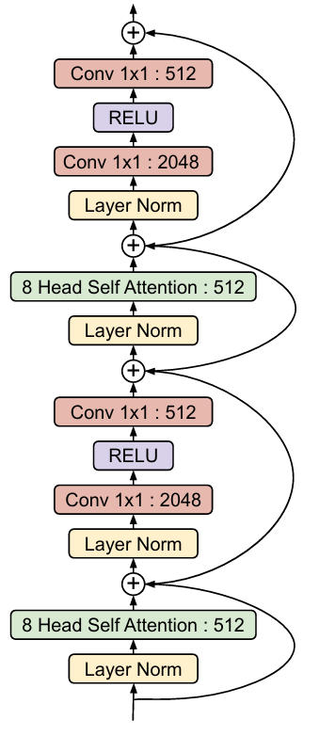
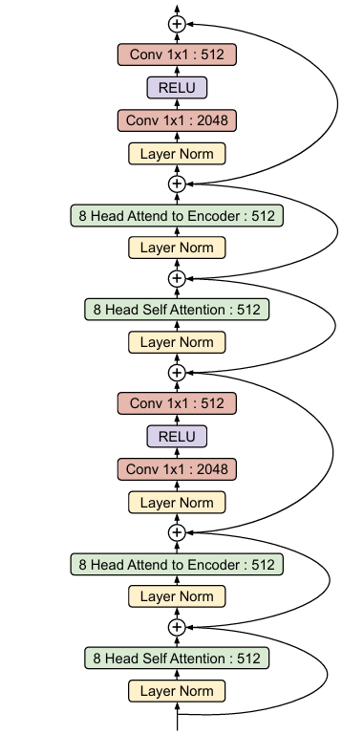
The Evolved Transformer: Architecture
The Evolved Transformer Encoder Cell
The Transformer Encoder Layer
The Evolved Transformer Decoder Cell
The Transformer Decoder Layer
Image: (So et al., 2019)
Notes:
the upper part of the ET encoder and normal encoder are the same,
also the upper part of the ET decoder and normal transformer encoder are the same, it changes the final activation function Swish in the ET decoder and RELU in the original transformer Decoder
the main training from scratch of the 20 best models has been done by SGD(not specified but infer from the paper
3 encoder cells, 4 decoder cells
extra: authors of ET also tried to apply one shot models but it took too much time and they claimed that warm start these with the Transformer was hard
initially they had a very big search space and to shrink it they did apply some constraint: always layer normalization, decoder architecture must at least attent to the encoder once
they used WMT’14 as the dataset to search a good architecture because they could nto find a good proxy dataset, they used aggressive early stopping on it
in PDH they stopped after in total 300k training steps
the mutation that seems to have the most important impact on the ET is to change the number of dec from 3 to 4
the child models during the EA can just have between 59.1mil and 64.1mil but then once the final architecture is found they shrank or expand the model accordingly
i dont understand: if if 5k child models how can 13k not make it past the 1st hurdle? isnt that in total we have 15k child models

Slide 73
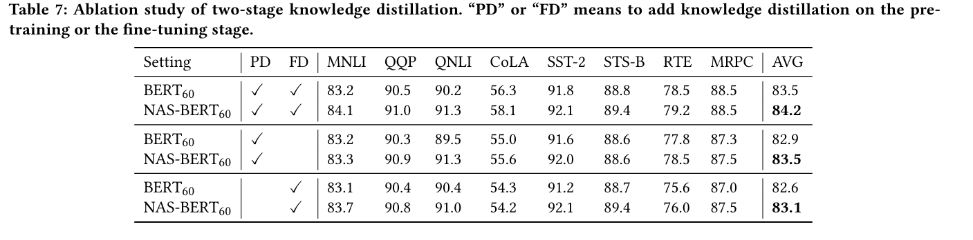
NAS-BERT: Ablation studies
Table: (Xu et al., 2021)
Notes:
NAS-BERTconsistently outperforms the BERT baseline in different settings; 2) distillation on either pre-training or fine-tuning stage can improve the accuracy, and two-stage distillation can further get better accuracy

Slide 74
NAS-BERT: Results
GLUE validation set
Table: (Xu et al., 2021)
Notes:
Spearman correlation is reported for STS-B.
Matthew scorrelation is reported for CoLA .
Accuracy is reported for other tasks.
represents the average of the metrics that are shown in the table
the speed up are compared to The baseline BERT models in Table2 are: BERT60 (L=10,H=512,A=8),BERT30 (L=6,H=512,A=8),BERT10 (L=6,H=256,A=4)andBERT5(L=6,H=128,A=2)
but speed up in terms of what?? performance? latency? seconds? i think to run inference
These are different NLP dataset that are part of the GLUE benchmark
MNLI (Multi-Genre Natural Language Inference): This dataset tests a model's ability to understand the relationship between two sentences. It has three categories: entailment (one sentence implies the other), contradiction (one sentence contradicts the other), and neutral (no relationship between the sentences).
QQP (Quora Question Pairs): This dataset asks the model to identify whether two questions are semantically equivalent (asking the same thing) or not.
QNLI (Stanford Question Answering Natural Language Inference): to understand the relationship between a question and a passage. It focuses on whether the answer to the question can be found in the passage (entailment) or not.
CoLA (Corpus of Literature Annotations): This dataset is a simple task of sentiment analysis. The model needs to classify sentences as positive or negative.
SST-2 (Stanford Sentiment Treebank): Similar to CoLA, this dataset tests sentiment analysis, but with a finer grain. The model needs to classify sentences as positive, negative, or neutral.
STS-B (Semantic Text Similarity Benchmark): This dataset asks the model to judge the semantic similarity between two sentences. The model outputs a score between 0 (not similar) and 5 (highly similar).
RTE (Recognizing Textual Entailment): Similar to MNLI, this dataset tests a model's ability to understand the entailment relationship between two sentences. However, RTE uses different phrasing and focuses more on factual entailment.
MRPC (Microsoft Research Paraphrase Corpus): This dataset asks the model to identify whether two sentences express the same meaning (paraphrases) or not.
what are this datasets?
- NAS-BERT models consistently outperform their hand-designed counterparts.
- Greater performance gap observed in smaller models.

Slide 75
The Evolved Transformer: PDH
30 architectures per Tournament selection
childs= 5000 per generation
train step s= <60, 60, 120>
Notes:
question: a little bit more on the training of the PDH, like for how much more were the good performing architecture allowed to train?
they wanted to approximate the 300k training step of the big transformer and they used 240k
After the main search is completed, the top 20 models based on the best perplexity were selected, retrain from scratch on the same dataset(WMT’14 En-De) and the final best one was picked as the ET.

Slide 76
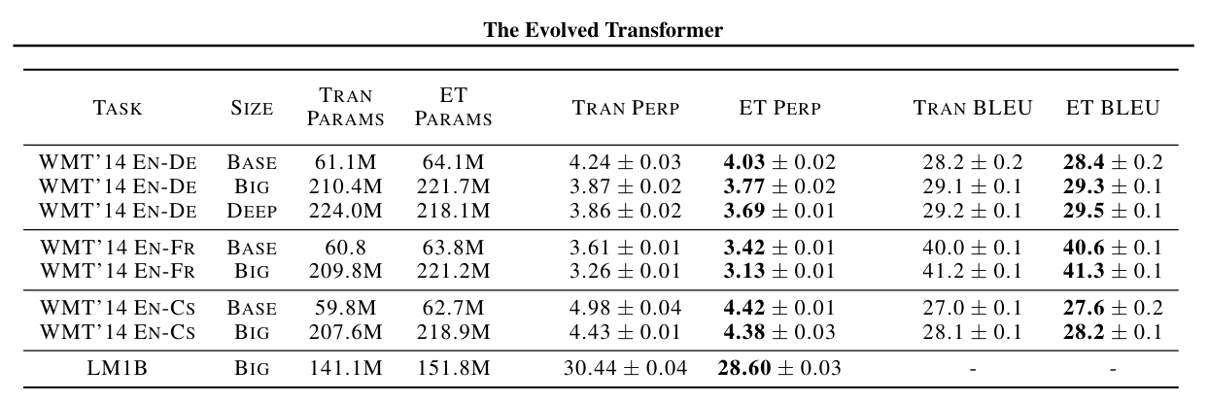
The Evolved Transformer: Results
Validation dataset
Test Dataset
Table: (So et al., 2019)
Notes:
base 512, big 1024 deep both with ET 3 enc and 4 dec cells
deep ET 640 9 enc 10 dec
deep transformer 768 6 enc and 6 dec

Slide 77
The Evolved Transformer: Encoding
[left input, left normalization, left layer, left
relative output dimension, left activation, right input, right
normalization, right layer, right relative output dimension,
right activation, combiner function]x14 + [number of cells]x2

Slide 78
About Myself
BSc in Statistics and Information Management
3rd Semester in MSc Statistics and Data Science
Research Assistant at the Bavarian AI Chair for Mathematical foundation of Artificial Intelligence
Notes:
tcyvugbhcxzwrexcyvbhjk jnbuvcrxectybhjn

Slide 79
NAS for Transformers: Search Space
Operations:
MHSA
Normalization
Feed Forward Layers
Convolution
Activation Functions
Connections:
Skipped Connections
Concatenation
Others:
Number of encoder/decoder layers
Hidden size
→ number of heads
→ dimension
→ kernel size
→ which one
Notes:
The building elements that define the architecture of a Transformer and that compose its search space in the papers that we will adress are :

